Slide 1

Dhaka University of Engineering and Technology (DUET), Gazipur ঢাকা প্রকৌশল ও প্রযুক্তি বিশ্ববিদ্যালয়, গাজীপুর
Detecting Multi-label Sentiment and Emotions from Bangla YouTube Comments (ICBSLP-2018)
Presenting by
N. I. md. Ashafuddula
Student ID: 18204016

Slide 2
Outlines
Introduction
Sentiment analysis
Multi-Label Sentiment
Dataset
Implementation Process
Experimental Evaluation
Reproduction of the Experiment
Result Discussion & Limitations
Conclusion
Future work
References

Slide 3
Introduction
Sentiment analysis has been key research area for opinion mining, emotion extraction, trend predictions in social media, etc.
In this paper, researchers presented a set of techniques to identify sentiment and extract emotions from Bangla texts.
They evaluated the performance using a new dataset of Bangla, English, Randomize Bangla comments from different types of YouTube videos.
Proposed approach shows 65.97% and 54.24% accuracy in three and five labels sentiment, which has more accuracy than baseline solutions and existing approaches.

Slide 4
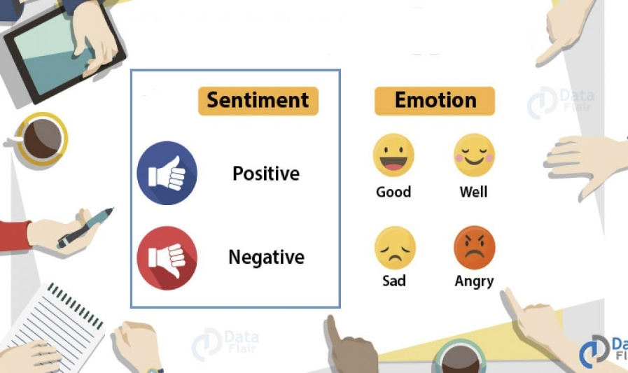
Sentiment analysis
Sentiment analysis is the interpretation and classification of emotions (positive, negative and neutral) within text data using text analysis techniques [2].
Helps to identify customer’s sentiment toward products, brands or services in online conversations and feedback.
Fig[1]: Sentiment analysis¹
[1] https://data-flair.training/blogs/data-science-r-sentiment-analysis-project/
[2] https://monkeylearn.com/sentiment-analysis/#:~:text=Sentiment%20analysis%20is%20the%20interpretation,in%20online%20conversations%20and%20feedback.

Slide 5
Multi-Label Sentiment
Negative Sentiment
Example:
1. “This video is not up to the mark”
2. “What a rubbish video it is !!!”
To overcome from this problem:
Three-class (positive, negative, neutral) and
Five-class (strongly positive, positive, neutral, negative, strongly negative) sentiment label
Negative Sentiment, but with more negative feelings and expresses disgust

Slide 6
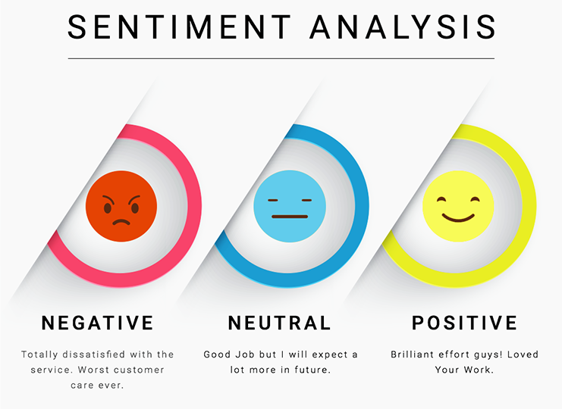
Objective
To classify a Bangla sentence with a three-class and a five-class sentiment label
Extract the emotion of a Bangla sentence as any one of the six basic emotions (anger, disgust, fear, joy, sadness and surprise).
Fig[3]: Extract emotion³

Slide 7
Dataset
Dataset collected from YouTube comments and annotate the data.
Extracted comments from different types of video domains as Table II, using YouTube API version 3.0.
Selected these videos in Bangla language based on their popularity (number of views, number of likes or dislikes) from 2013 to early 2018.
Limit the number of comments for each video up to 50 to remove redundancy and also exclude the replies.
Used Google translator to detect the language of each comment. Unidentified languages considered as Romanized Bangla.

Slide 8
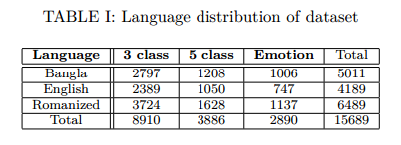
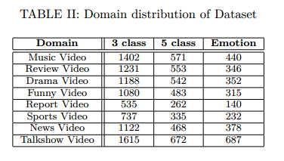
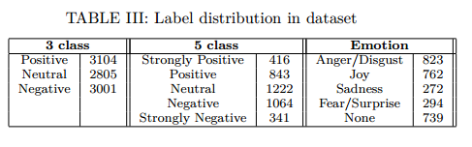
Dataset (Cont’d)

Slide 9
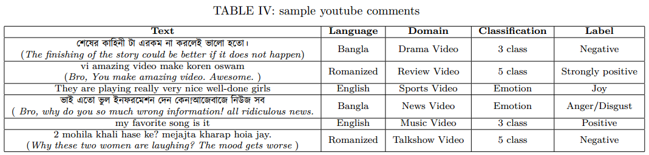
Dataset (Cont’d)

Slide 10
Implementation Process
Preprocessing:
Remove noise, duplication, errors, un-necessary information, links, urls, user tags and mentions from comments.
Tokenize each sentence and remove stop-words from them.
Word Embedding Representation
To represent each word in a sentence as vector, they used Word2Vec.
Used both Continuous Bag Of Words (CBOW) and Skip Gram (SG)
Created a vocabulary of size D from text corpus.
Each sentence in the corpus is transformed into a one-hot encoding vector of length D and feed forward these vectors to a Neural Network.

Slide 11
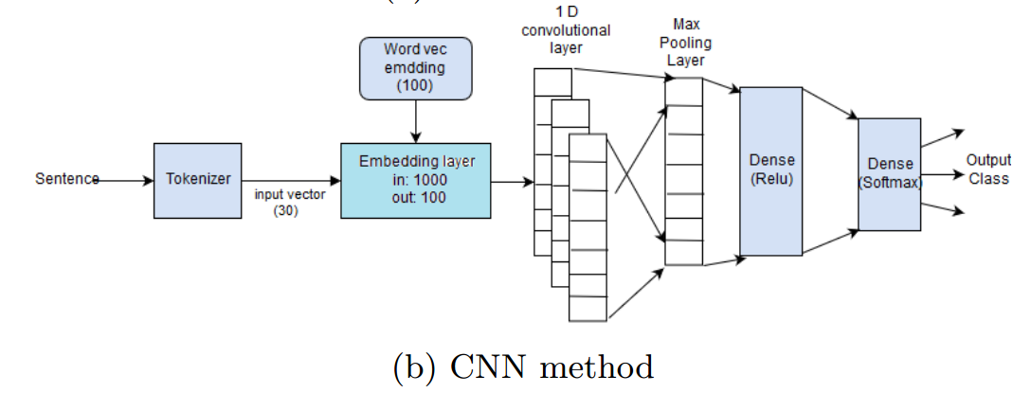
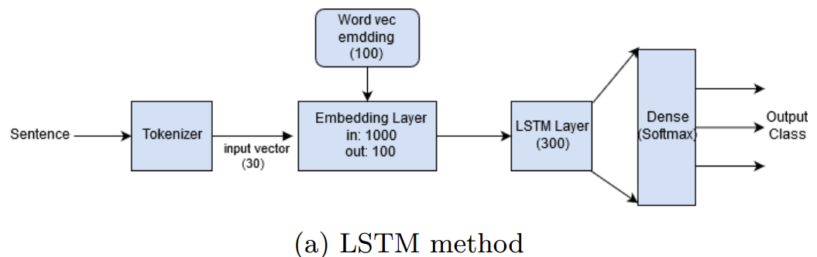
Implementation Process (Cont’d)
Neural network consists of 1 hidden layer with M nodes. Output layer has D nodes where each node denotes probability. (in this paper, M=100 used)
Model Architecture:
Fig[4]: Architecture for sentiment and emotion classification

Slide 12
Implementation Process (Cont’d)
Long Short Term Memory (LSTM)
Preprocessed sentences passed through a tokenizer to produce a one-hot encoding vector of length 30.
They only consider the top 1000 most frequent words in the vocabulary and skipped the sentences that are more than 30 words long and pad with zeros for shorter comments.
Then these vectors are feed into an embedding layer and the weights are initialized with word2vec embedding eights.
The output dimension of the embedding layer is 100 as it is the vector length of each word in the word2vec model. The sequence of 30 words is then fed into an LSTM layer.
Finally, they added a dense layer with softmax as activation function since each sentence can belong to only one class in this scenario.
The number of nodes in the dense layer is equal to the number of classes in a specific problem.

Slide 13
Implementation Process (Cont’d)
Convolutional Neural Network (CNN)
After embedding layer, they added a 1D convolutional layer with 100 filters. The next global max-pooling layer extracts the maximum value from each filter and the output dimension is a just 1D vector with length as same as the number of filters they applied.
This vector is directly passed to a dense layer (ReLu activation) without any filtering.
The final output layer is a softmax layer with several labels as an output node.

Slide 14
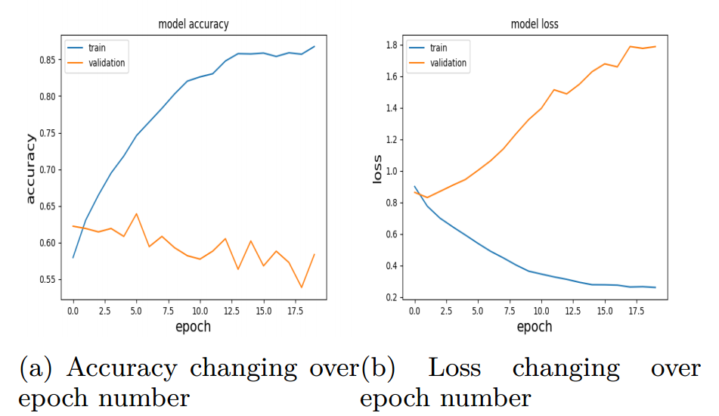
Implementation Process (Cont’d)
Long Short Term Memory (LSTM), Convolutional Neural Network (CNN) and to evaluate performance other baseline methods are used.
Fig[5]: Effect of epoch number in train and validation accuracy and loss

Slide 15
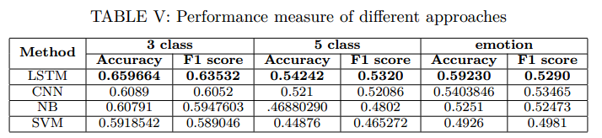
Experimental Evaluation
They Compared the performance of their solutions with baseline SVM and Naive Bayes(NB) approach.
Fig. 5 shows the accuracy increases for training set as epoch number increases but loss in validation set increase also. Therefore, the problem of over-fitting prevails in their approach.
Table V shows both LSTM and CNN out performs baseline SVM and NB approach in all classification scenario
LSTM is slightly better than CNN is most of the cases but CNN is much faster.

Slide 16
Reproduction of the Experiment
To reproduce the experiment system must need Nvidia GTX 960M with 4GB memory to run Deep Learning algorithms.
Due to the Lackings of Nvidia Nvidia GTX 960M Graphics, My laptop is unable to reproduce the experiment.

Slide 17
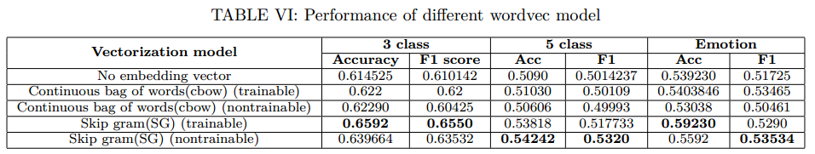
Result Discussion & Limitations
Discussion:
The highest achievable accuracy for 3 and 5 class sentiment analysis is 65.97% and 54.24% respectively. For five category emotion detection, the accuracy is 59.23%.
Between CBOW and SG, Skip-Gram (SG) model provides highest accuracy and F1 score in all the cases.

Slide 18
Result Discussion & Limitations (Cont’d)
Model performs better in detecting emotion from English text and worst performs for randomize Bangla text.
Model accuracy decreases for news type videos as comments in this domain contain various topics and ambiguous thoughts. However, comments from review type videos score a higher accuracy in their method as they are more polarized.

Slide 19
Conclusion
Model for multi-label sentiment achieved at least 10% more accuracy than baseline solutions and existing approaches.
Observed that the performance of their approach increases in domain or language specific texts.
The analysis focus on identifying three class and five class sentiment label which is rare in Bangla language

Slide 20
Future Work
In future they want to include, multiple aspects and topic information in sentiment and emotion detection.

Slide 21
References
[1] A. Das and S. Bandyopadhyay, “Sentiwordnet for bangla,” Knowledge Sharing Event-4: Task, vol. 2, 2010.
[2] S. Chowdhury and W. Chowdhury, “Performing sentiment analysis in bangla microblog posts,” in Informatics, Electronics & Vision (ICIEV), 2014 International Conference on. IEEE, 2014, pp. 1–6.
[3] M. S. Islam, M. A. Islam, M. A. Hossain, and J. J. Dey, “Supervised approach of sentimentality extraction from Bengali facebook status,” in Computer and Information Technology (ICCIT), 2016 19th International Conference on. IEEE, 2016, pp. 383–387.
[4] A. K. Paul and P. C. Shill, “Sentiment mining from bangla data using mutual information,” in Electrical, Computer & Telecommunication Engineering (ICECTE), International Conference on. IEEE, 2016, pp. 1–4.
[5] R. Feldman, “Techniques and applications for sentiment analysis,” Communications of the ACM, vol. 56, no. 4, pp. 82–89, 2013.

Slide 22
References
[6] T. Mikolov, K. Chen, G. Corrado, and J. Dean, “Efficient estimation of word representations in vector space,” arXiv preprint arXiv:1301.3781, 2013.
[7] Y. Kim, “Convolutional neural networks for sentence classification,” arXiv preprint arXiv:1408.5882, 2014.
[8] C. dos Santos and M. Gatti, “Deep convolutional neural net-works for sentiment analysis of short texts,” in Proceedings of COLING 2014, the 25th International Conference on Computational inguistics: Technical Papers, 2014, pp. 69–78.
[9] Y. Zhang and B. Wallace, “A sensitivity analysis of (and prac-titioners’ guide to) convolutional neural networks for sentence classification,” arXiv preprint arXiv:1510.03820, 2015.
[10] H. Shirani-Mehr, “Applications of deep learning to sentiment analysis of movie reviews,” in Technical Report. Stanford University, 2014.

Slide 23
References
[11] P. Ekman, “An argument for basic emotions,” Cognition & emotion, vol. 6, no. 3-4, pp. 169–200, 1992.
[12] P. K. Bhowmick, “Reader perspective emotion analysis in text through ensemble based multi-label classification framework,” Computer and Information Science, vol. 2, no. 4, p. 64, 2009.
[13] V. K. Singh, “Sentiment analysis research on bengali language texts,” International Journal of Advanced Scientific Research Development (IJASRD), vol. 02, pp. 122–127, 2015.
[14] M. Al-Amin, M. S. Islam, and S. D. Uzzal, “Sentiment analysis of bengali comments with word2vec and sentiment information of words,” in Electrical, Computer and Communication Engineering (ECCE), International Conference on. IEEE, 2017, pp. 186–190.
[15] A. Hassan, M. R. Amin, N. Mohammed, and A. Azad, “Sentiment analysis on bangla and romanized bangla text (brbt) using deep recurrent models,” arXiv preprint arXiv:1610.00369, 2016.

Slide 24
References
[16] D. Das and S. Bandyopadhyay, “Developing bengali word net affect for analyzing emotion,” in International Conference on the Computer Processing of Oriental Languages, 2010, pp. 35–40.
[17] R. E. Jack, O. G. Garrod, and P. G. Schyns, “Dynamic facial expressions of emotion transmit an evolving hierarchy of signals over time,” Current biology, vol. 24, no. 2, pp. 187–192, 2014.
[18] T. Pranckevičius and V. Marcinkevičius, “Comparison of naïve bayes, random forest, decision tree, support vector machines, and logistic regression classifiers for text reviews classification,” Baltic Journal of Modern Computing, vol. 5, no. 2, p. 221, 2017.

Slide 25
THE END

